Slide 1
Methyl Acetate Manufacture
Progress Report #4
Team T - Abdul Fayeed, Adarsh Kannan, Gavin Guerrera
April 21st, 2022

Slide 2
Overview: Topics to be Discussed
Objectives for MeOAc production.
Changes made to the block flow diagram(BFD).
Heat Integration Process to save on utilities.
BOE sizing and economic results for both scenarios(pre and post HI).
Sensitivity analysis to indicate which variables have the biggest impact on transfer price
Risk Analysis.
Final conclusions.

Slide 3
MeOAc Manufacture Objective
Objective of our process is to manufacture 375 MMppy of MeOAc per annum.
Since we have selected carbonylation as our route, the following purity specs must be met.
MeOH <100 wt ppm
H₂O <100 wt ppm
DME < 100 wt ppm

Slide 4
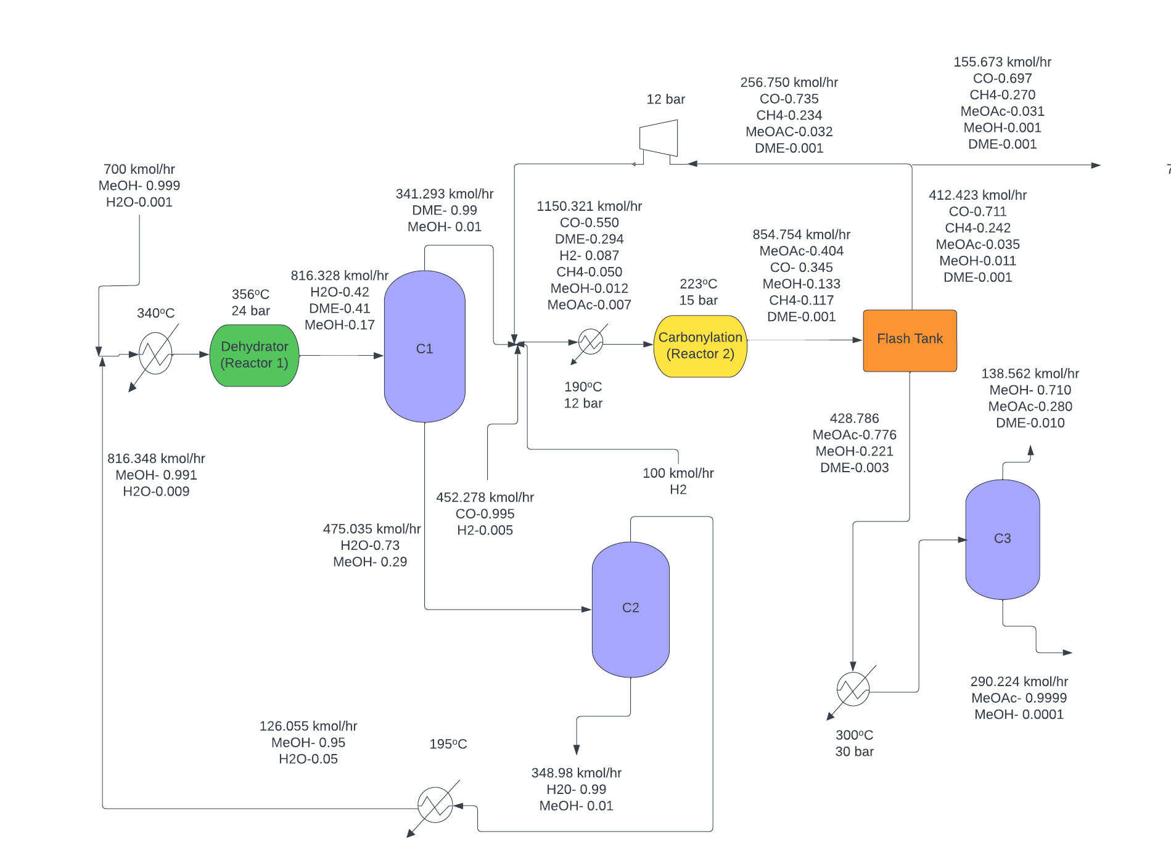
Overview of BFD and changes made from PR3
Couldn’t solve for the recycle structure of CO.
Excessive fired heaters utilized before distillation columns.
New BFD incorporates a recycle stream, and removes the two fired heaters present before C1 and C2.

Slide 5
Carbon Monoxide Purge Improvements
Old design purged $12.4 million in raw materials.
New design purged $5.05 million in raw materials.
New design requires $3.23 million in H_{2.}
Additional catalyst amount costs $1.26 million .
Total savings of $2.89 million .

Slide 6
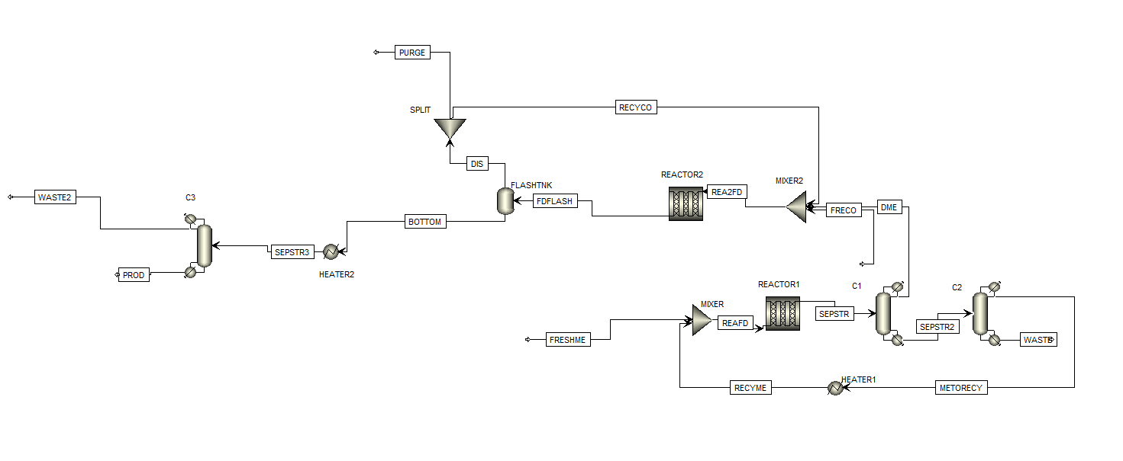
Changes Made to BFD

Slide 7
Heat Integration: Stream Identification
*Cold: Cold Streams to be Heated *Hot: Hot Streams to be Cooled
Stream Identification | Stream Type | Stream Label
S7_To_S8 (Heater) | Cold | C1
BOTTOM_To_S14 (Heater2) | Cold | C2
To Reboiler@B13_TO_S15 (C3) | Cold | C3
To Reboiler@B7_TO_S6 (C2) | Cold | C4
To Condenser@B7_TO_S7 (C2) | Hot | H1
To Condenser@B13_TO_S16 (C3) | Hot | H2
To Condenser@B6_TO_S9 (C2) | Hot | H3
To Reboiler@B6_TO_S5 (C1) | Cold | C5
Flash Tank | Hot | H4
Reactor (Carnomylator) | Cold | C6
Reactor(Dehydration) | Hot | H5

Slide 8
Building Heat Cascade Table - Cold Streams
Label | T^{S} (ºC) | T^{T} (ºC) | mCp (kJ/kgK) | Q (kW)
H1 | 97.03 | 95.35 | 1947.86 | 3265.51
H2 | 167.90 | 4.82 | 83.91 | 13685.78
H3 | 42.77 | 32.10 | 1070.41 | 11420.50
H4 | 223.00 | 14.00 | 21.75 | 5800.44
H5 | 356.00 | 355.50 | 18592.30 | 9296.15
Total |  |  |  | 43468.41

Slide 9
Building Heat Cascade Table - Cold Streams
Label | T^{S} (ºC) | T^{T} (ºC) | mCp (kJ/kgK) | Q (kW)
C1 | 95.35 | 195.00 | 12.58 | 1253.56
C2 | 14.00 | 300.00 | 27.47 | 6141.33
C3 | 179.89 | 180.39 | 19970.21 | 9985.10
C4 | 120.01 | 127.85 | 383.80 | 3009.47
C5 | 137.80 | 139.89 | 438.66 | 917.08
C6 | -22.06 | 223.00 | 27.28 | 6687.54
Total |  |  |  | 27994.09
First Law Requirement |  |  |  | 15474.32

Slide 10
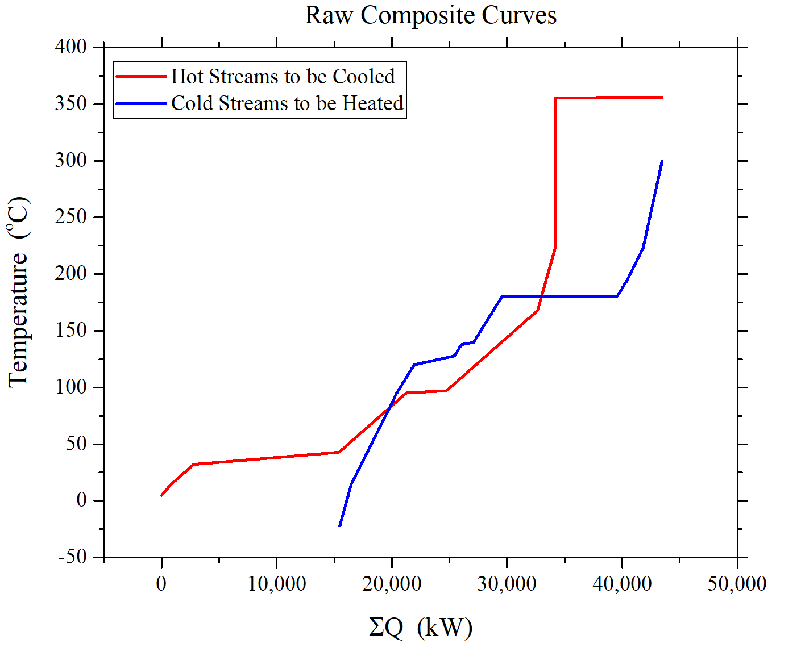
Raw Composite Curves

Slide 11
Building Heat Cascade Table : Part 2
Interval (ºC) | Streams | ∑mCph-∑mCpc (kJ/KgK) | ∑Q (kW) | Added Heat (kW)
346.00 |  | 0.00 | 0.00 | 4454.01
345.50 | H5 | 18592.31 | 9296.15 | 13750.16
300.00 | None | 0.00 | 9296.15 | 13750.16
223.00 | C2 | -21.47 | 7642.72 | 12096.72
213.00 | C2,C6 | -48.76 | 7155.10 | 11609.11
195.00 | H4,C2,C6 | -21.01 | 6776.95 | 11230.96
180.40 | C1,C2,H4,C6 | -33.59 | 6286.47 | 10740.48
179.90 | C3,C1,C2,C6,H4 | -20003.81 | -3715.43 | 738.58
157.91 | C1,C2,H4,C6 | -33.59 | -4454.01 | 0.00 (PINCH)
139.90 | C1,C2,C6,H2,H4 | 50.33 | -3547.63 | 906.38
137.81 | C1,C2,C5,C6,H2,H4 | -388.34 | -538.16 | 3915.85

Slide 12
Building Heat Cascade Table (contd.)
Interval (ºC) | Streams | ∑mCph-∑mCpc (kJ/KgK) | ∑Q (kW) | Added Heat (kW)
127.86 | C1,C2,C6,H4,H2 | 50.33 | -37.38 | 4416.63
120.02 | C1,C2,C4,C6,H2,H4 | -333.48 | -2652.23 | 1801.78
95.35 | C1,C2,C6,H4,H2 | 50.33 | -1410.91 | 3043.09
87.03 | C2,C6,H2,H4 | 62.91 | -887.31 | 3566.70
85.35 | C2,C6,H1,H2,H4 | 2010.77 | 2483.67 | 6937.67
32.77 | C2,C6,H2,H4 | 62.91 | 5791.04 | 10245.05
22.11 | C2,C6,H4,H2,H3 | 1133.32 | 17882.71 | 22336.72
14.00 | C2,C6,H4,H2 | 62.91 | 18392.61 | 22846.61
4.00 | C6,H4,H2 | 84.38 | 19236.40 | 23690.41
-5.18 | C6,H2 | 56.63 | 19756.43 | 24210.44
-22.07 | C6 | -27.29 | 19295.66 | 23749.66

Slide 13
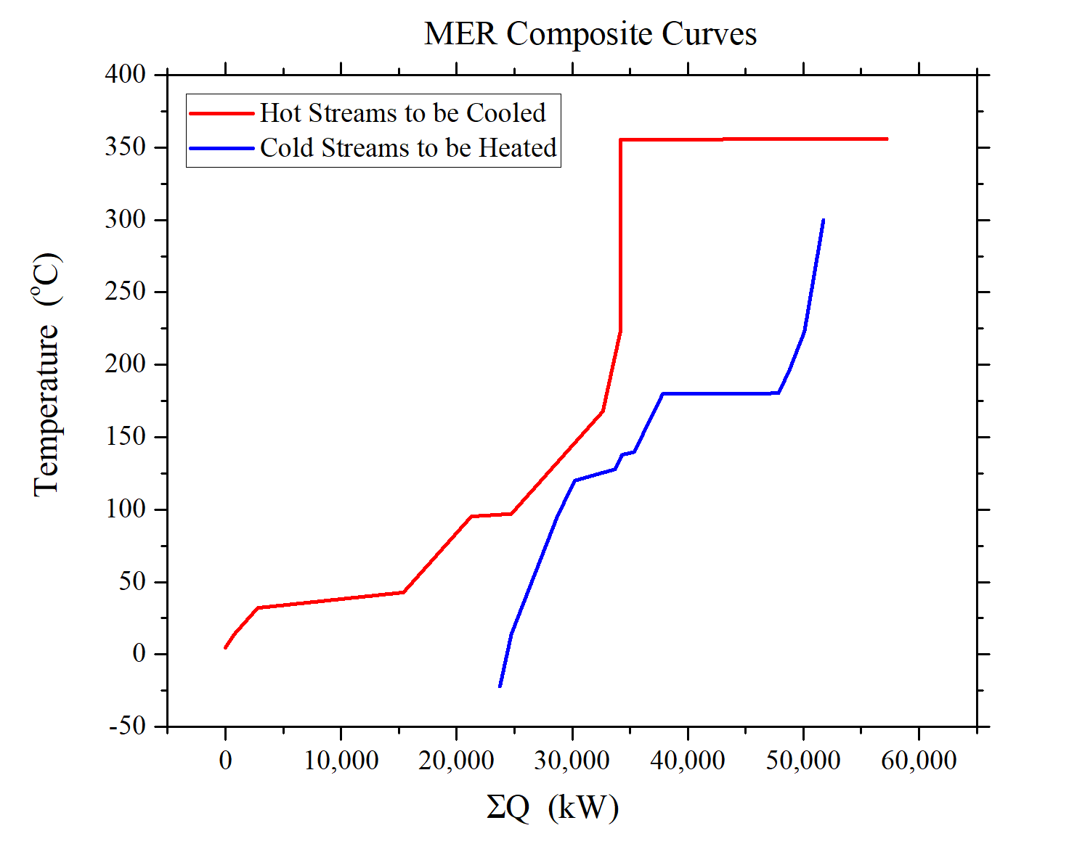
MER Composite Curves

Slide 14
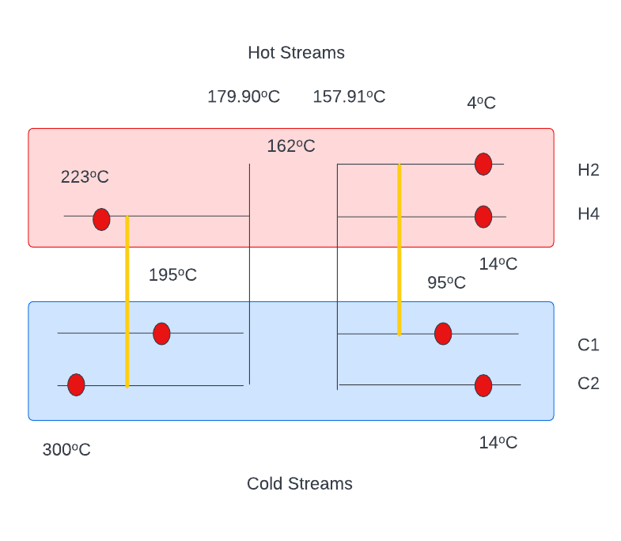
Stream Matching

Slide 15
Utility Improvements
Old Utility Potential Savings: 61.00 Gcal/hr
New Utility Potential Savings : 19.56 Gcal/hr
Effective Change: 68% improvement in energy utilization

Slide 16
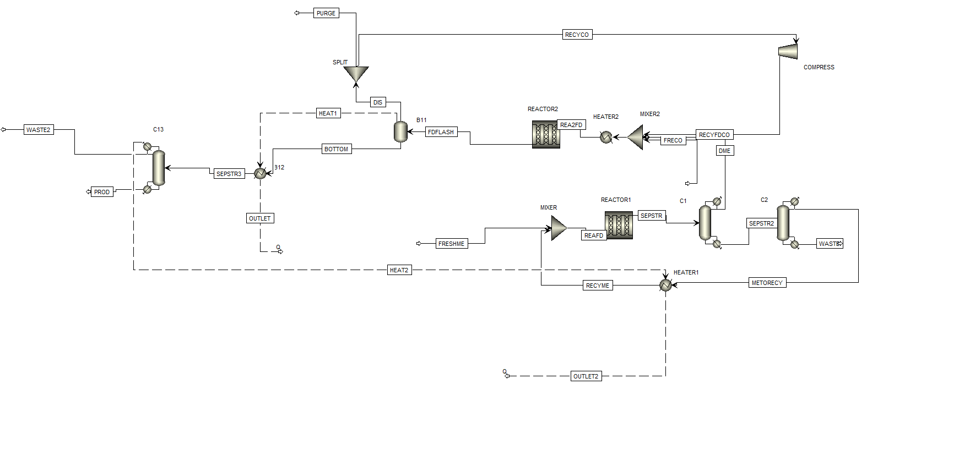
Updated PFD

Slide 17
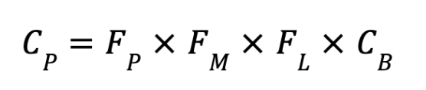
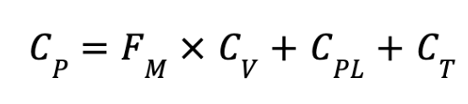

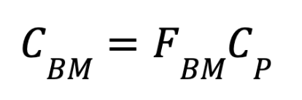
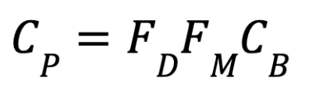
Economics Equations (Purchase Cost C_{P})
Heat exchanger
Distillation column/vertical pressure vessels
Fired heater
Compressor
Bare-module cost
The following equations were obtained from Seider, Seader, Et Al.

Slide 18
Equipment Costs Comparison
Reactor 1 | 243,510
Reactor 2 | 10,293,729
Reboiler 1 | 25,277
Condenser 1 | 80,458
Reboiler 2 | 36,864
Condenser 2 | 38,252
Reboiler 3 | 76,698
Condenser 3 | 96,029
Flash tank | 97,901
Heater 1 | 551,627
Heater 2 | 353,997
Heater 3 | 338,784
Heater 4 | 1,244,548
Compressor | 968,695
Column 1 | 862,333
Column 2 | 501,284
Column 3 | 862,333
Total CBM ($MM/yr) | 16.67

Slide 19
Revised Economic Analysis
VGA ($MM/yr) | 54
COM ($MM/yr) | 185
Transfer Price @ 25% NROI ($/tonnes) | 1,040
IRR (%) | 27.17
NPV ($MM/yr) | 4
NPC ($MM/yr) | 293

Slide 20
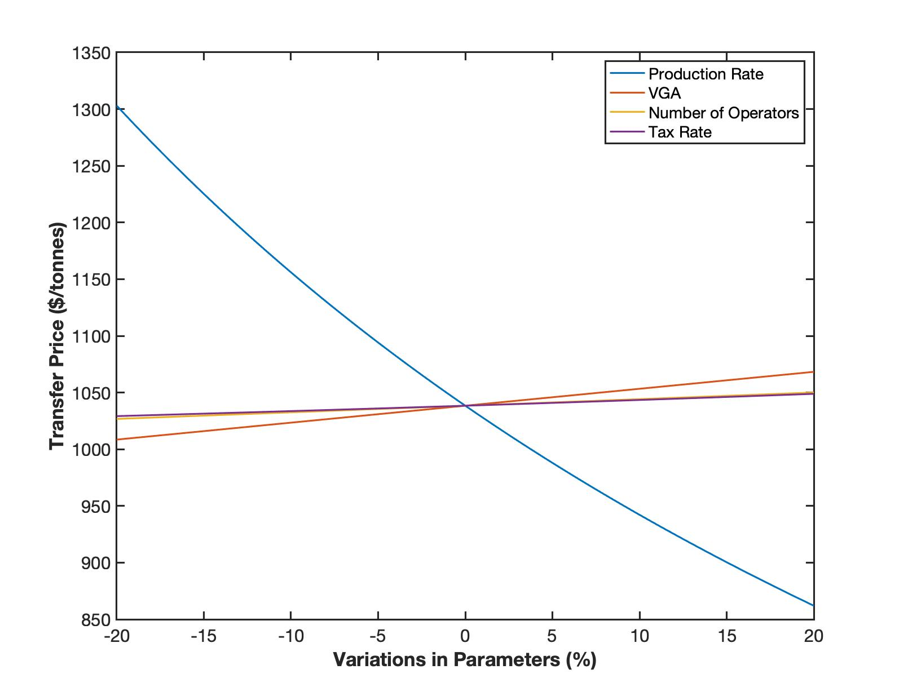
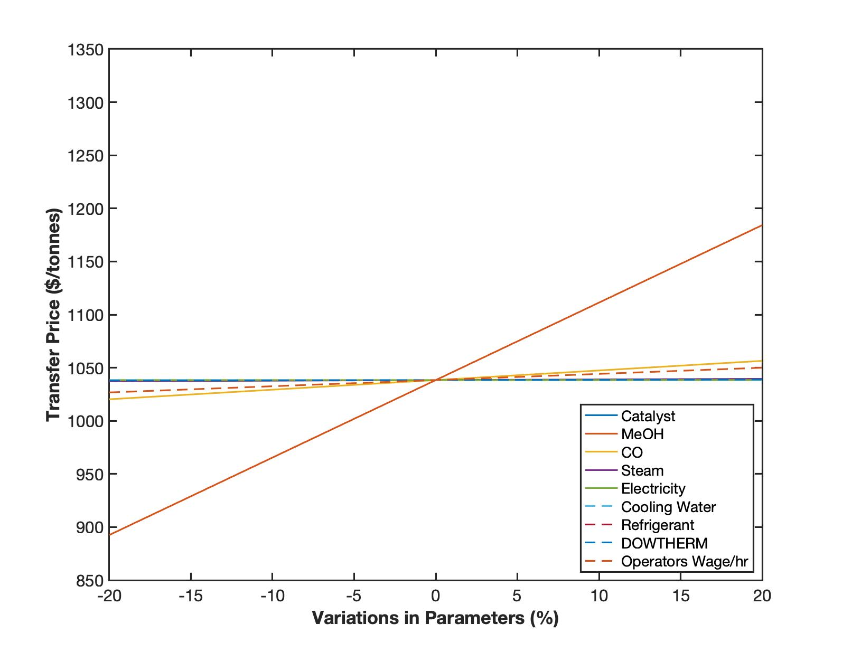
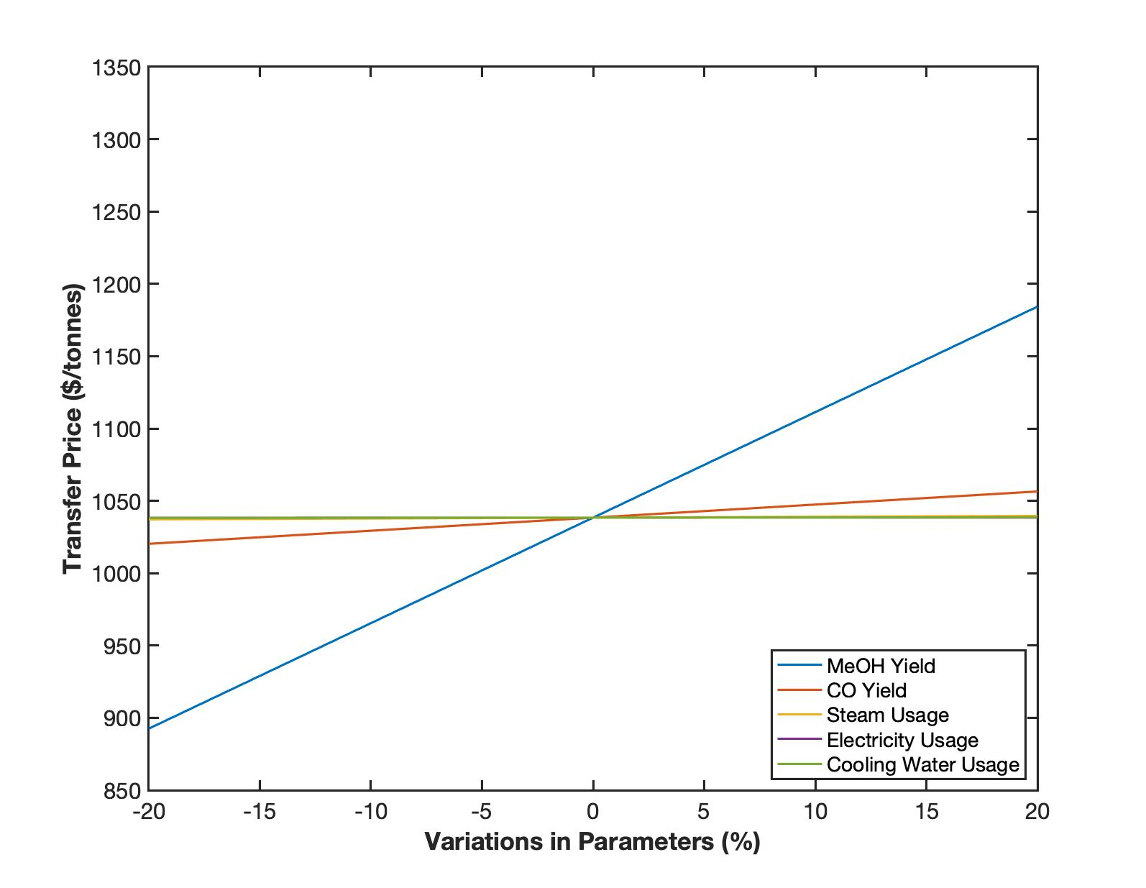
Sensitivity Analysis

Slide 21
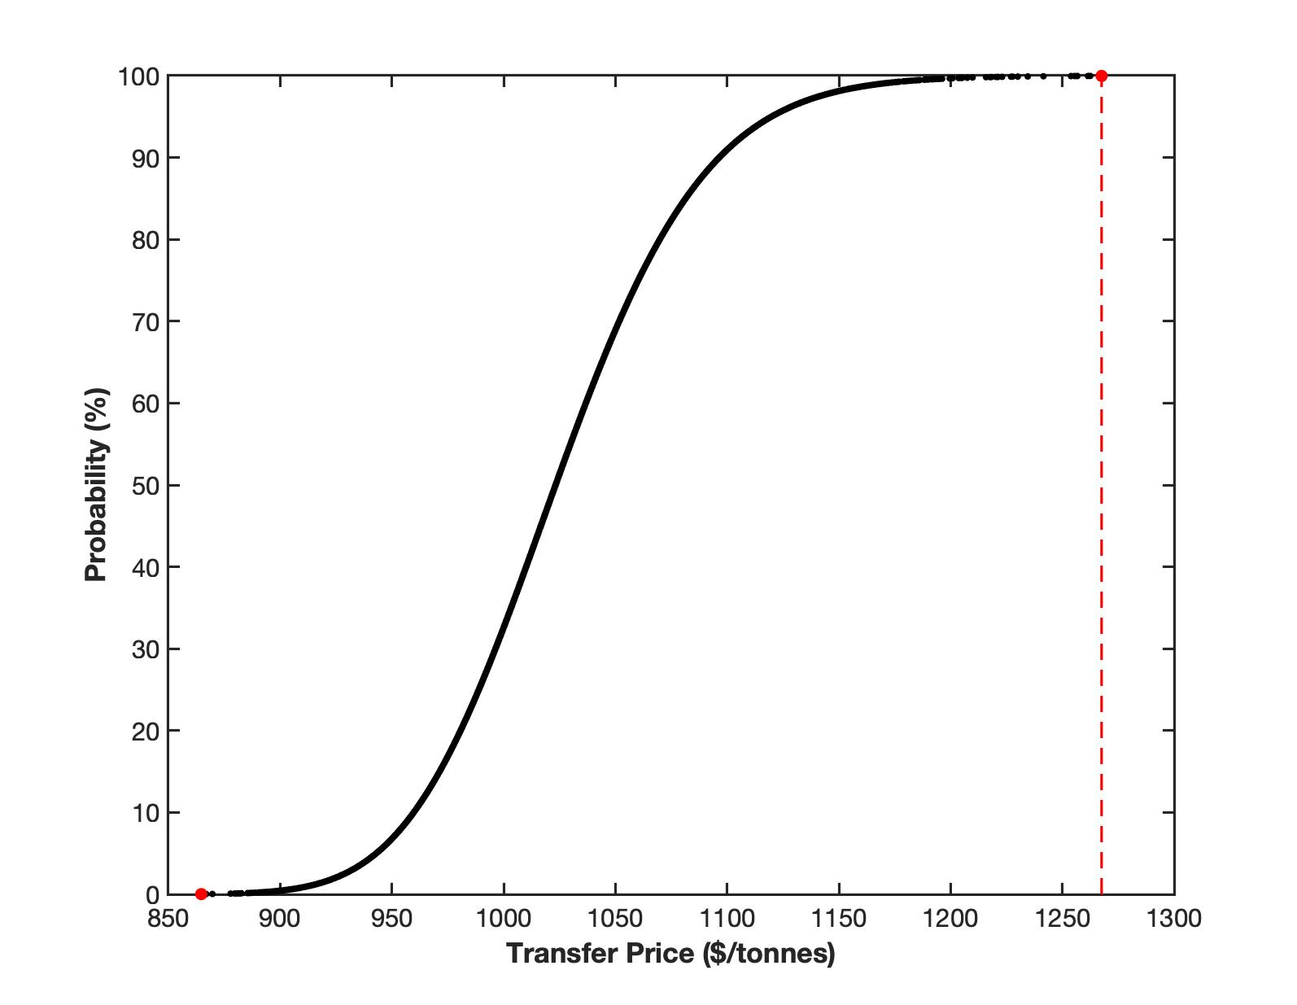
Monte Carlo Simulation
Production rate
Number of operators
VGA
Tax rate
Price of MeOH and CO
Yield of MeOH and CO
Operators’ wage
Min = $875/tonnes
Max = $1270/tonnes
Range = $395/tonnes
Median = $1040/tonnes

Slide 22
Risk Assessment
Main Risks Identified
Hazards Associated with H₂,CO,DME,MeOH,CH₄
Corrosion, Highly Flammable, Toxic, Explosive under Pressure
Contaminated Water Purge
Methanol Contamination in Environment/ Drinking Water
Chemical Releases
Fines, dangerous chemicals, possible explosion

Slide 23
Risk Assessment (contd.)
Pressure Buildup
Ruptured Vessels, Equipment Failure
Temperature Changes
Catalyst Degradation, Equipment Failure

Slide 24
Mitigation Steps
Hazards Associated with H₂,CO,DME,MeOH,CH₄
Preventative Measures from staff, Utilization of PPE, Design Considerations
Contaminated Water Purge
Water Treatment
Chemical Releases
Relief Valves, Alarm Systems/Controls

Slide 25
Mitigation Steps (contd.)
Pressure Buildup
Pressure Relief Valves, Sensors
Temperature Changes
Temperature Sensors, Additional Coolant

Slide 26
Conclusions
Carbon monoxide recycle implemented
Heat integration reduced utilities by 68%
MeOH yield is the major factor for determining transfer price and MeOAc yield
Major risks identified and will be further analyzed

Slide 27
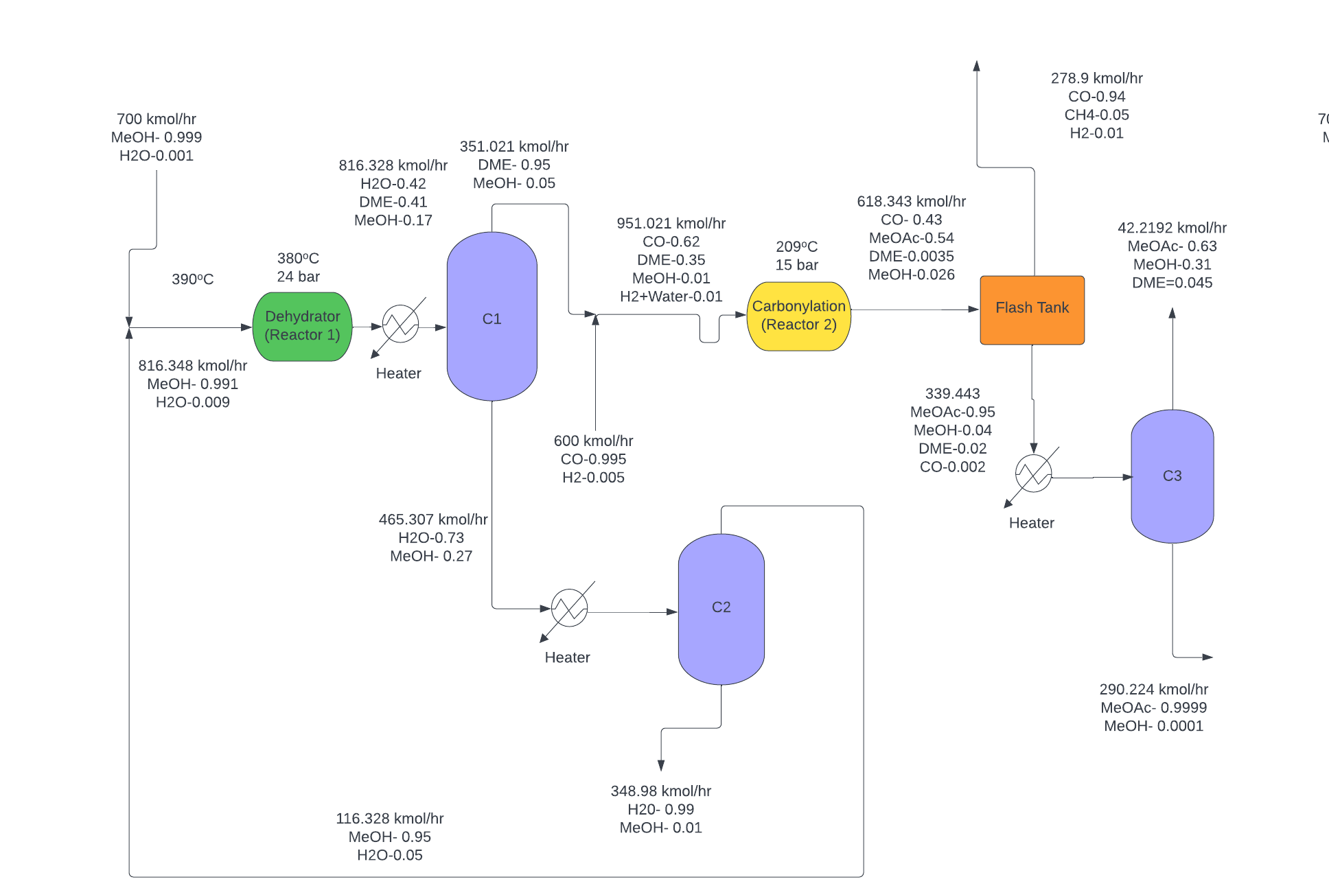
Finalized Flows (Previous PFD)

Slide 28
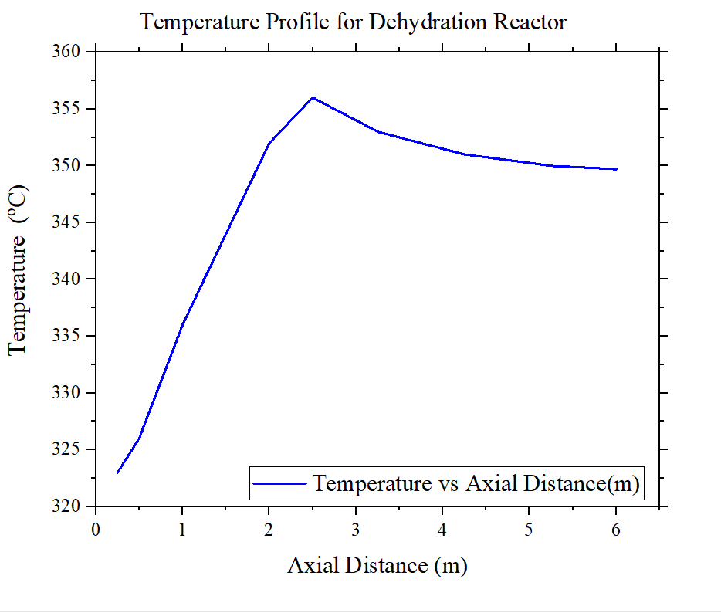
Temperature Profile for Dehydration Reactor

Slide 29
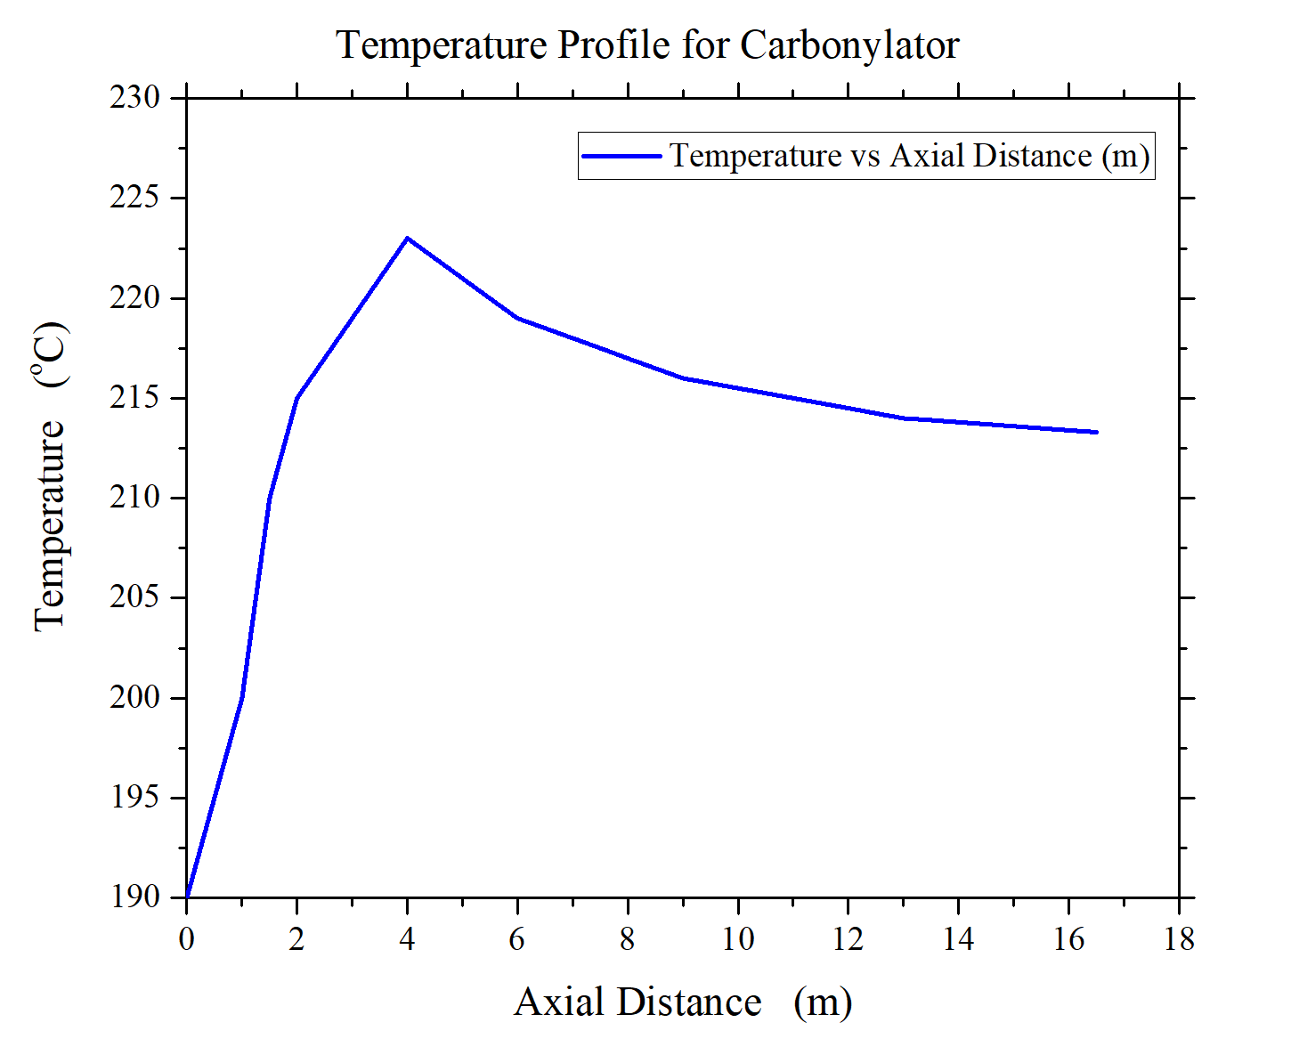
Temperature Profile for Carbonylation Reactor

